Slide 1

NUFEB
A new frontier in design – the simulation of open-engineered biological systems
Statistical emulation as a tool for analysing expensive computer model outputs
Oluwole Oyebamiji

Slide 2

Aims of talk
Objectives: NUFEB project
Simulator and emulator
Key attributes of LAMMPS model
Procedure for building an emulator
Gaussian process (kriging)
Relevant LAMMPS model outputs for emulation
Results and future works

Slide 3
Overview
The ability to perform reliable simulation in an open engineered biological systems could potentially lead to new innovations
One of the crucial aspects of the NUFEB project is the simulation of biological floc/biofilm models that scales from one level to another to better understand how to effectively managed real systems
The models are computationally expensive and can involve a computer run of several days
Computationally cheaper models can be obtained from large
ensembles of simulations using statistical emulation

Slide 4
Objectives: NUFEB Project
Use IB model to create library of output for different input scenarios
Development of complex statistical algorithms, optimised to minimise execution time
Develop new methods of emulator-based multi-scale modelling
Fundamental question here is the development of statistical algorithms for emulation and calibration of complex multi-scale stochastic biological models (LAMMPS)

Slide 5
Simulator and emulator
A simulator is a model of a real process. Typically implemented as a computer code
Think of it as a function taking inputs x and giving outputs y
y = f(x)
An emulator statistical approximation to the simulator
It is a fast and cheaper surrogate for a computationally expensive computer model

Slide 6
Continue……….
Expressing knowledge/beliefs about what the output will be at
any given input(s)
Built using prior information and a training set of model runs
The Gaussian process (GP) emulator expresses f as a GP conditional on Hyperparameters
Use mainly for interpolation; sensitivity analysis; uncertainty
analysis ; calibration purpose etc

Slide 7
Key attributes of LAMMPS model
Expensive to evaluate - we can not run them at every parameter combination of interest, which limit the amount of information
The LAMMPS model is stochastic
The model produce high-dimensional and multiple outputs
The LAMMPS model is dynamic
Despite all these caveats, the good news is that there is a large number of literature that have addressed some of these
problems, and we are applying suitable ones to our case

Slide 8
Procedure for building an emulator
Screening: which simulator inputs matter; what are plausible
input range; constraints in the input combinations; elicit beliefs about input distributions
Experimental design: where to run the simulator. Space-filling methods choose points which are reasonably evenly spread throughout the input space to obtain uniform coverage
- This will avoid parameter space for which we don't have a simulator run (eg Latin Hypercube Design (LHD))

Slide 9
Continue……..
Output behaviour: stochastic/ deterministic; multiple outputs;
multi-scale emulator
Gaussian processes (GPs) extend multivariate Gaussian distributions to infinite dimensionality. A Gaussian process is a statistical distribution Y(t), t ∈ T, for which any finite linear combination of samples has a joint Gaussian distribution, one can write Y ~ GP(m,K), where m=mean, K=covariance function
Model structure: mean and covariance functions
Mean function……….

Slide 10
Continue………. Regression form - h(x)^{T}β
For modelling large shape of response
Covariance function
Common kernels are: Gaussian, Matern, Exponential, Power etc
Gaussian kernel = σ²exp{-(x-x′) ^{T} α⁻²(x-x′)} is very popular
Hyperparameters β, σ² and α
Inference: building emulator and estimating parameters
Emulator is the posterior distribution of f by integrating out (β,σ²)
Cross-validation: check validity of emulator

Slide 11
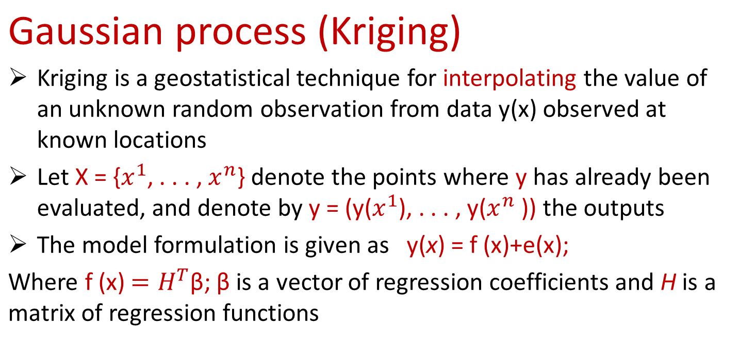

Slide 12
Continue………
Є(x) - stochastic Gaussian process characterized by its covariance function K =Cov(Є(x); Є(x’))= σ² C(x;x’), and σ² is a process variance
Assign MLE technique to estimate model parameters Ɵ = {β, σ², α}
After solving some mathematical equations, the BLUP predictor is ŷ(x)= h(x) ^{T}βˆ+t(x) ^{T}C ⁻¹[y-Hβˆ]
and
K*= σ²{c(x,x’),-t(x) ^{T}C ⁻¹ t(x) +[h(x) ^{T} - t(x) ^{T}C ⁻¹ t(x) ](H^{T}C ^{-1H})⁻¹ [h(x’) ^{T} - t(x’) ^{T}C ⁻¹ t(x’) ] }

Slide 13
Relevant LAMMPS outputs for emulation
Biofilm / floc total mass at each time step
Biofilm / floc equivalent diameter at each time step
EPS total mass at each time step
Total number of particles at each time step
Mass ratio of individual particle to the total biofilm / floc
Distribution of biofilm/floc diameter
Change in the nutrient environment of the floc/Biofilm

Slide 14
Conceptual framework
The macroscale characteristics of wastewater treatment plants
are the consequences of microscale features of a vast number of individual particles that produce the biofilm/floc
There is a need to understand the interactions of microbes at
fine resolution based models that could provide the best available representation of micro scale responses
The challenge then becomes how we can transfer this small scale information to the macroscale process in a computationally efficient way

Slide 15
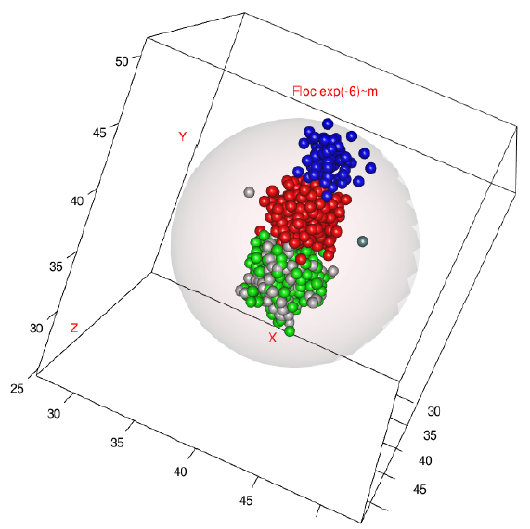
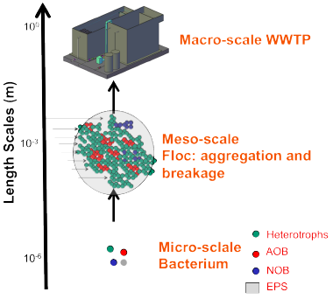
Continue………

Slide 16
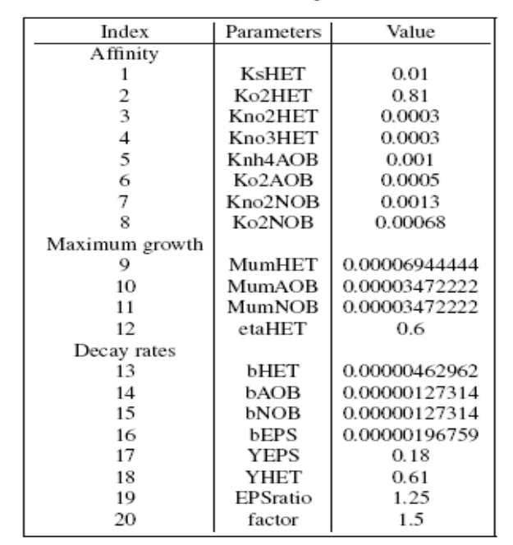
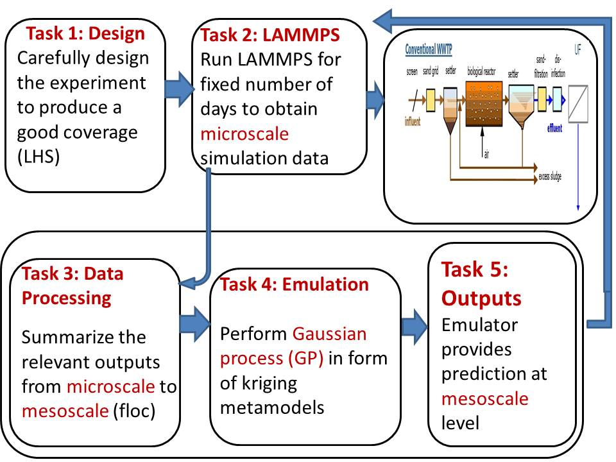
Key stages of LAMMPS emulation

Slide 17
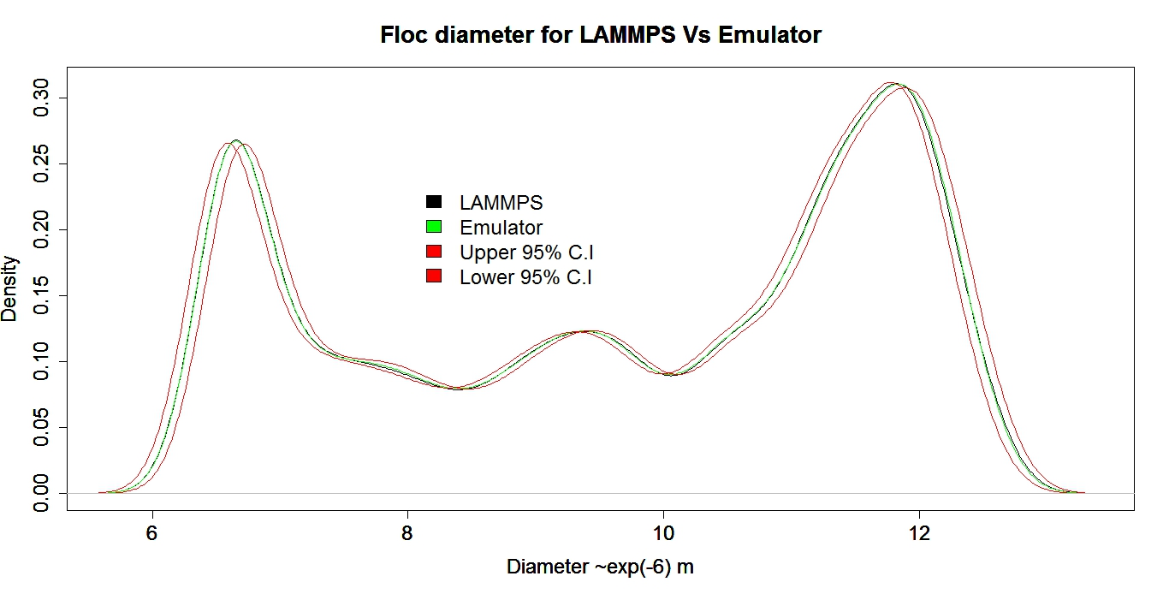
Floc diameter density function
Results
Comparison of the LAMMPS simulation with emulator predictions in form of probability density function (pdf)
Simulated and predicted values fall between 95% C.I except in few cases

Slide 18
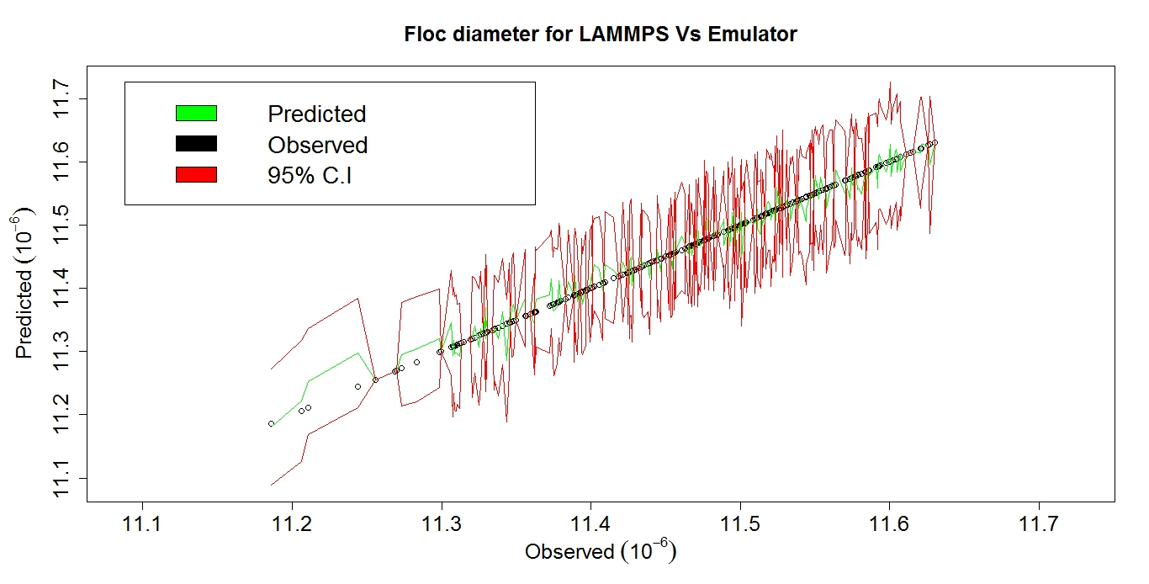
Result 2
Linear plots of comparison of the LAMMPS simulation with predictions.
Each observed point represents different time points
Most of the points are well fitted by the emulator
Floc diameter increases with time

Slide 19
Emulator Performance:
It takes LAMMPS model between (13-24 hours) to obtain 2 days simulation ensembles on 8G ram, 4-cores Linux machine.
Emulator gives results almost instantaneously (~1 minute).
This is ~1100-fold increase in computational efficiency.
The percentage of variance explained (~87%) on a test data for cross validation.

Slide 20
Future work
Continue to run the LAMMPS model for long time simulation
Improve on the emulation results
Explore other relevant statistical techniques that can handle big data emulation
Address other statistical issues relevant to LAMMPS emulation and calibration
Draft emulation paper for floc/biofilm

Slide 21


